Slide 1
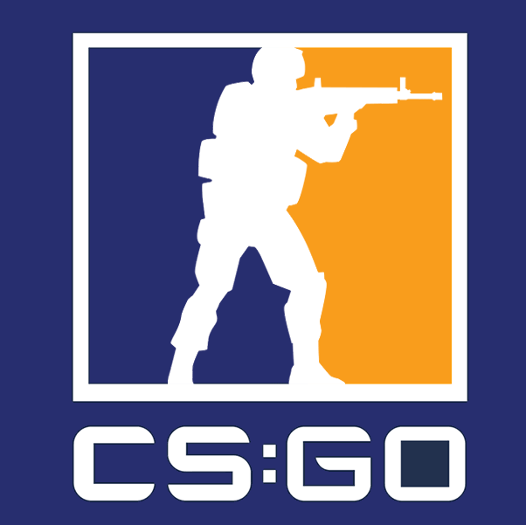
Counter-Strike: Global Offensive
Data Science Analysis
Project Group M -
Michael Bejma (45180997),
Satwik Chodisetti (45218641) and
Matthew Fleming (45169071)

Slide 2
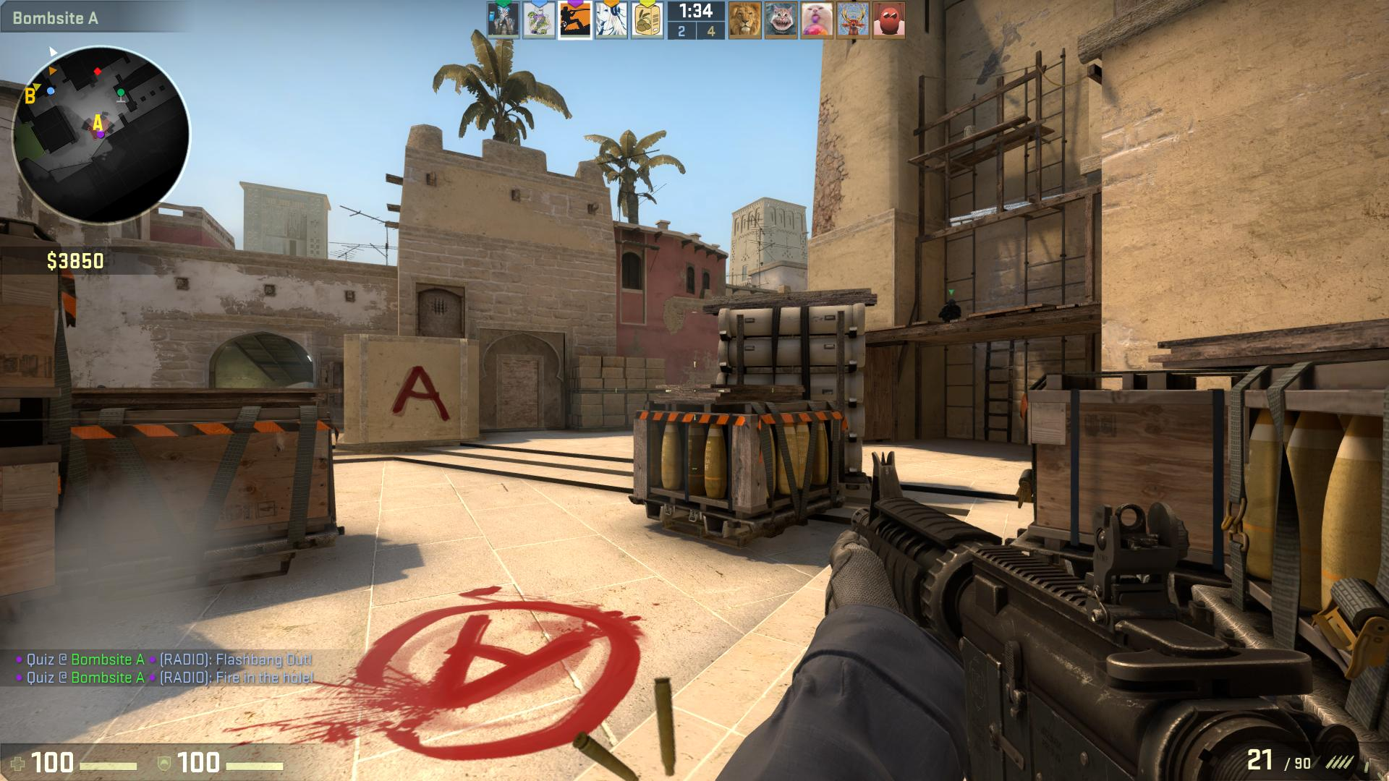
What Is Counter Strike: Global Offensive?
CS:GO is a skill-based, team-oriented, attack/defence first person shooter.
Teams of 5 compete against each other on both Terrorist and Counter-Terrorist sides.
The first team to reach 16 round wins out of 30 rounds is the winner, else the game results in a draw.

Slide 3
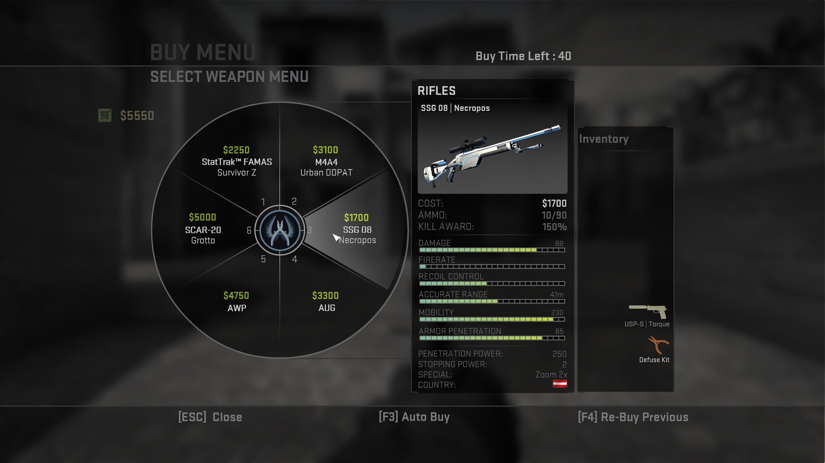
Why CS:GO?
CS:GO is renown as a skill-based shooter.
Unique aspects, such as in-game economy, team strategy, individual player skill.
A well-celebrated esport, with events such as the ESL One tournament, with a prize pool totalling over $300,000.

Slide 4

Problem Statement and Goals
“What factors contribute to winning rounds and games in CS:GO?”
Our goals: 1. To create heat maps of action so we can identify where duels are most likely to take place. 2. Predictions based on rank, economy and use of certain weapons. 3. Performing analysis on player rank vs game factors. 4. Creating a model which could predict who would win a round given a number of factors.

Slide 5
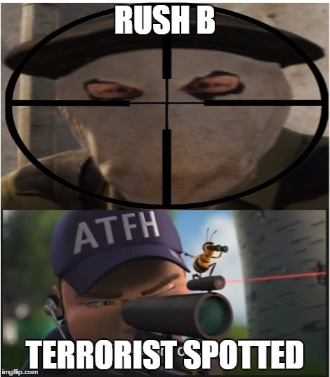
Our Data
Our Data was obtained via Kaggle.
The data includes roughly 410,000 rounds of gameplay from the game’s September 2018 update.
The data was 3.37GB. We needed to cull the data in order to fit it into our github repository, which is limited to 1GB in size.
The dataset includes information on the game state.
The state of the economy, whether bombs have been planted, what round and map is being played.
Other information about player positioning, weapons and damage numbers is also relevant.

Slide 6
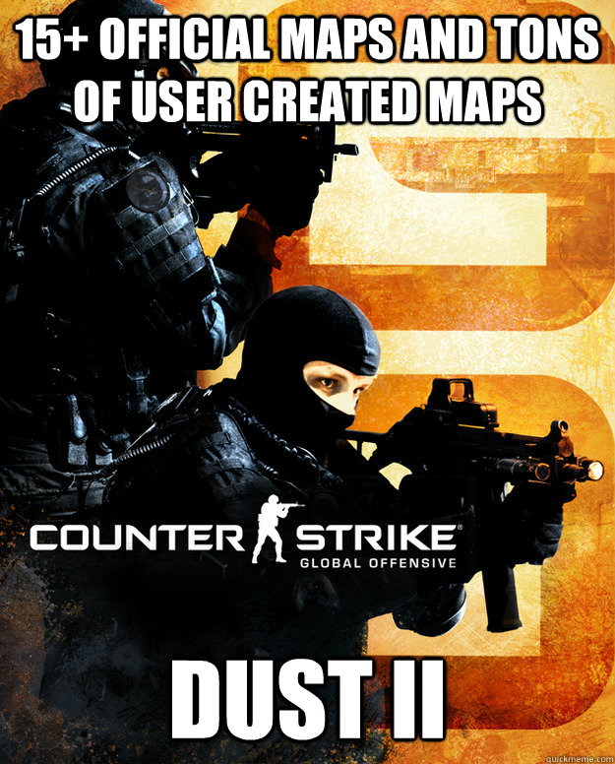
Preprocessing The Data
3 main .csv files were used, which includes separate frames for duels, grenades, and map data.
This was due to some data from the other .csv files being incomplete.
NaN values were dropped in order for our analyses to work.
To preprocess the data, we changed the team names in the files to a consistent ‘Team 1’ and ‘Team 2’.
We dropped unplayed maps, leaving us with the seven most popular maps.

Slide 7
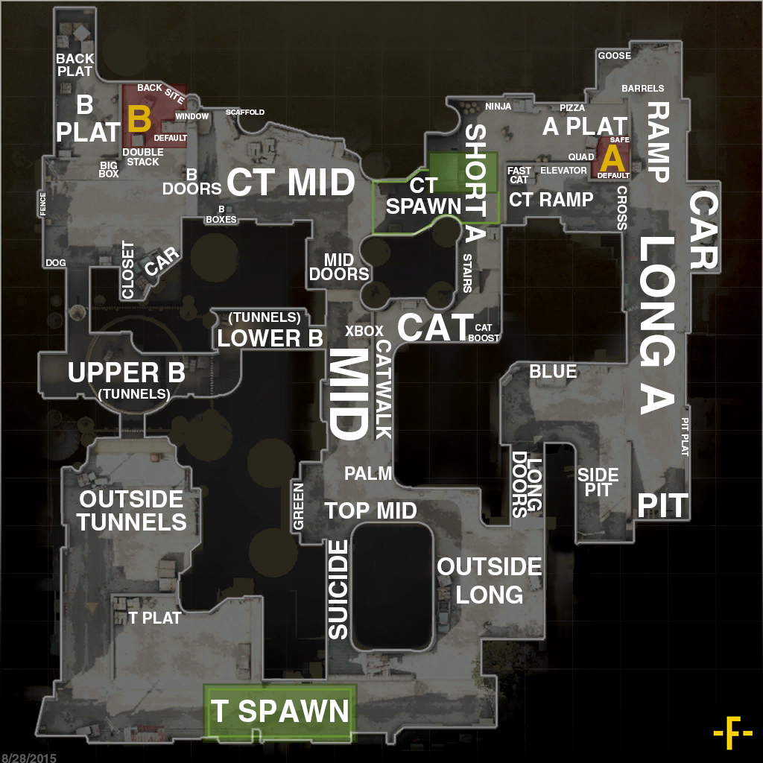
Contact Points Analysis (K-Means Clustering)
We used K-means clustering to find the zones in which combat happens on a map.
The data was separated by map and side.
The idea of this analysis is to understand where most engagements happen, in order to optimise around this. For example, utilising grenade throws.
de_dust2 is the most recognisable map in CS:GO.
We should be able to identify the names and relevant locations with the k-means clustering.

Slide 8
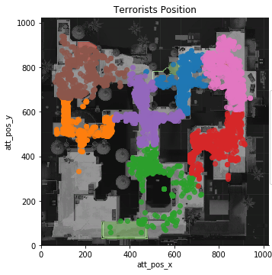
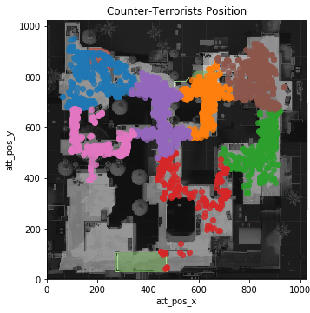
K-Means Clustering On de_dust2
The data shows most of the action happens when the Terrorists pass through Long A doors
Other locations include Bombsite A, Short A, top mid, and B tunnels.
This analysis could be used on other maps to identify the contact points.

Slide 9
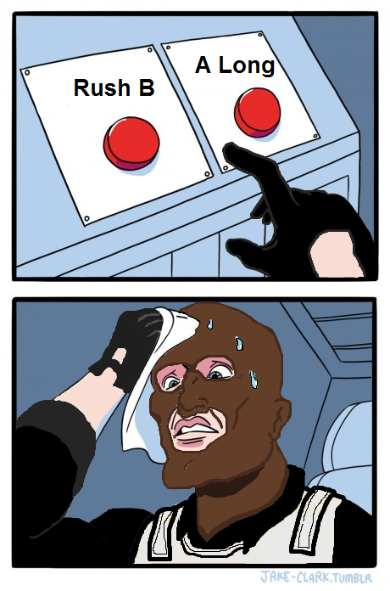
Heat Maps
Similarly to K-means clustering, heat maps will show us where the action is happening.
The results will show us where the highest concentration of action is happening on a given map.
Used in conjunction with map data, this is an easy way to find where chokepoints are.

Slide 10
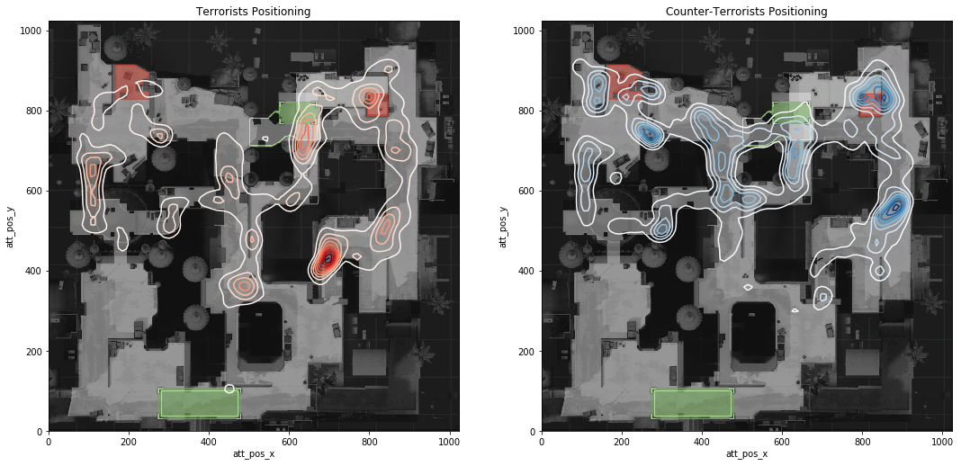
Heat Maps On de_dust2
The data shows most of the action happens when the Terrorists pass through Long A doors
Other locations include Bombsite A, Short A, top mid, and B tunnels.
This analysis could be used on other maps to identify the contact points.

Slide 11
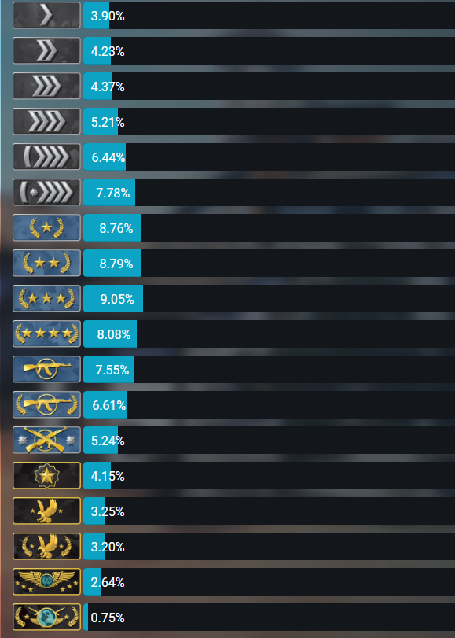
Weapon, Economy and Rank
In mm_master_demos we are given the “hits” across multiple rounds and the wp and weapon type used in that damage.
We can get some impressions of the data as well as the game by making some plots and seeing which guns or weapon types are more popular for fighting.
This will be broken down by low and high rank so we can see if there is any difference between the skills levels.

Slide 12
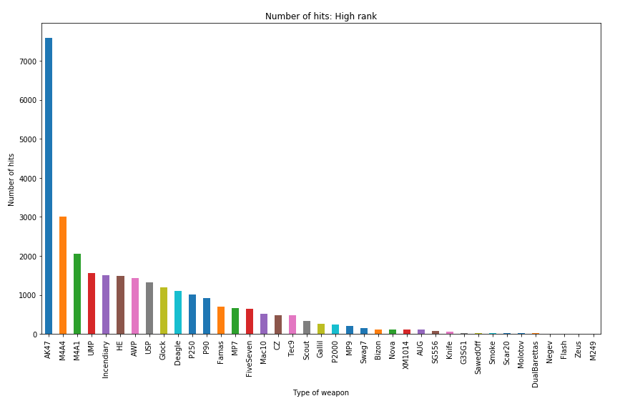

Slide 13
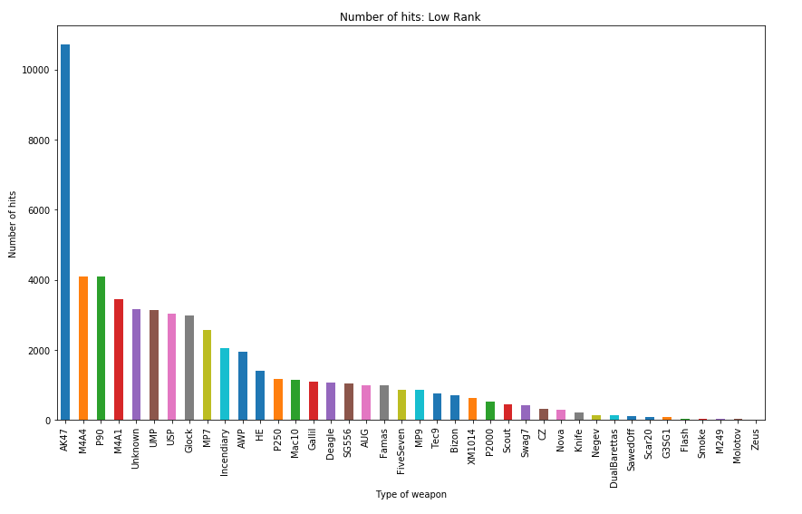

Slide 14
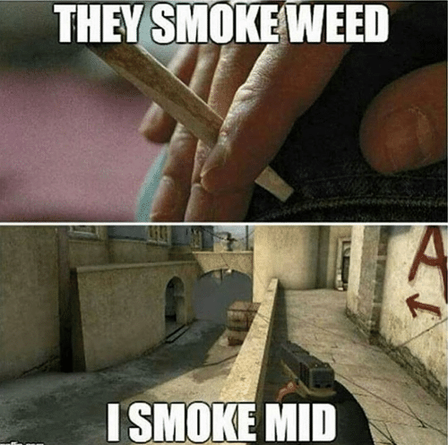
Smoke Grenade Strategy
Smokes are an important strategic tool that can conceal the movement of friend and foe.
Using mm_grenade_demos we can track data points for smoke grenades thrown throughout the game.
We will observe the difference between high-ranked and low-ranked players.

Slide 15
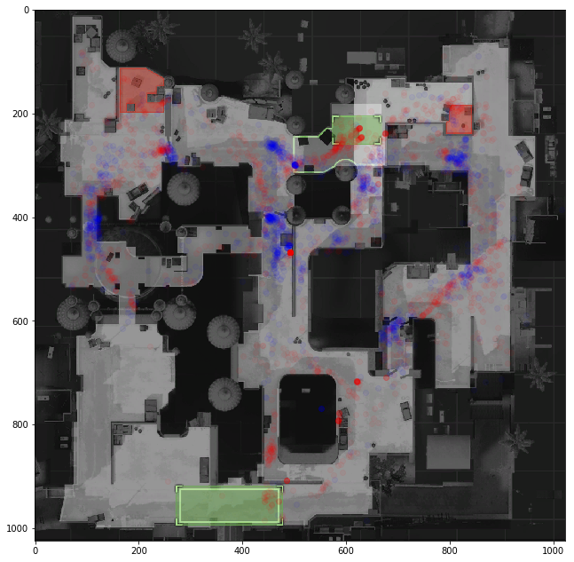
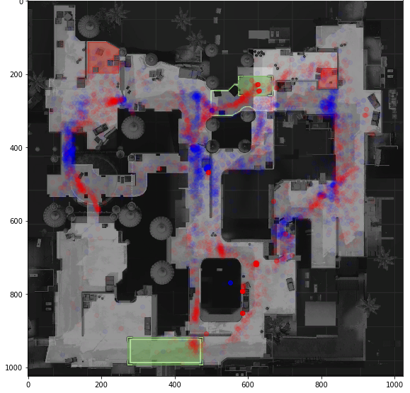
Smoke Grenade Throws On de_dust2
The left chart is the high ranked players, and the right is the low ranked players.
Red indicates where the smoke bomb is thrown from. Blue indicates where it landed.
Strategies don’t change between skill levels, however the individual precision and accuracy does change.

Slide 16
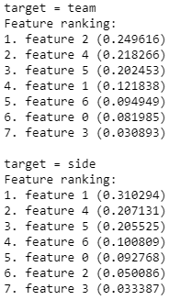
Predicting Outcomes (Ranking Features)
To predict the outcomes, we took a slice of the dataframe to include variables about the game state.
Then, we removed all entries that included duplicate rounds.
We ran a feature ranking algorithm to show what factors influence outcomes most.
We found that economy had approximately a 40% influence on the outcome of both rounds and overall games (features 4 and 5).
Feature 1 is what round is being played. The high score of this feature shows that the different teams are stronger at different stages of the game.
Feature 2 contributes towards overall game wins, because the team that plants the bomb more often is the team that is more likely to win.

Slide 17
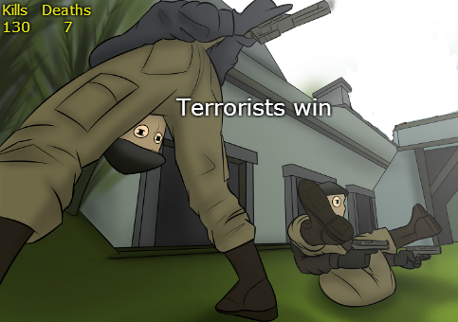
Predicting Outcomes (Naive Bayes)
Understanding what factors contribute to wins, we ran a Naive Bayes Analysis on the selected features.
The analysis tells us that game outcomes are much easier to predict than round outcomes.
This is because game wins have the context of the rounds before it, when round wins do not.
A game win can be predicted with approximately 69% accuracy.
A round win can be predicted with approximately 53% accuracy, which is only marginally better than guessing.

Slide 18
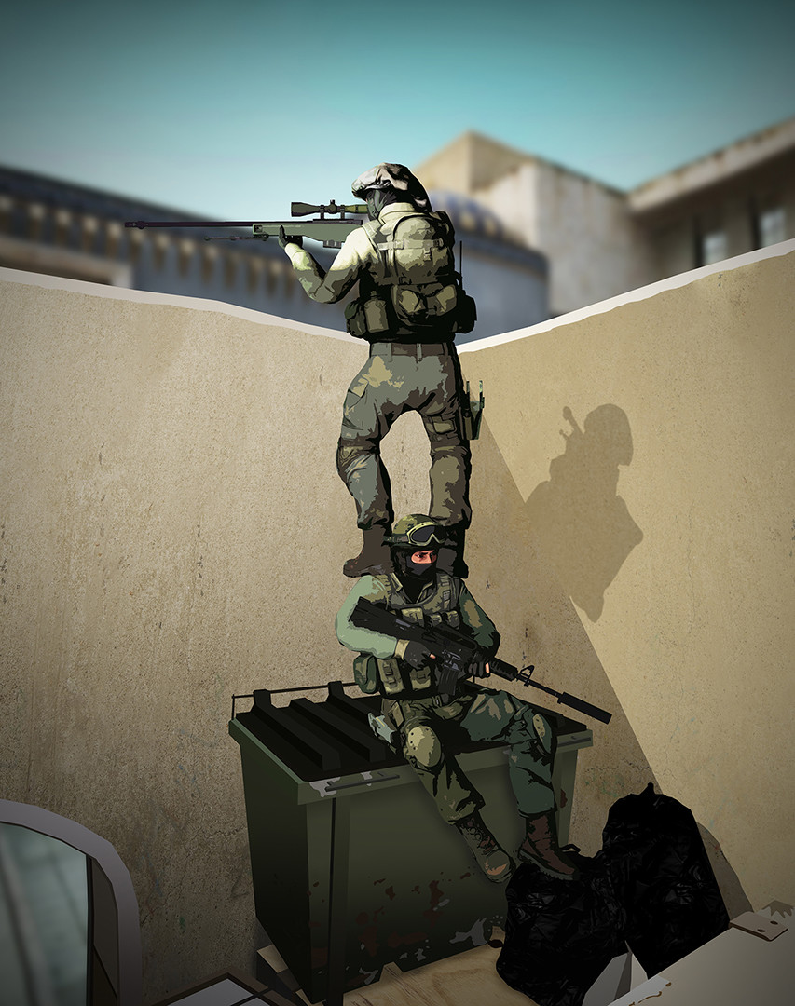
Conclusion
Our analysis makes a few things clear:
Maps of player coordinates can be used to find the concentration of action in a given map.
Rank guarantees greater consistency in performance, in regards to weapon choice and strategy.
Economy plays a vital role in the game, to the point where it accounts for up to 40% of round-winning strategy.
Predicting the outcome of a given round is not necessarily better than guessing.
Games are won and lost on the ability for players to string together individual and team strategy.

